Slide 1
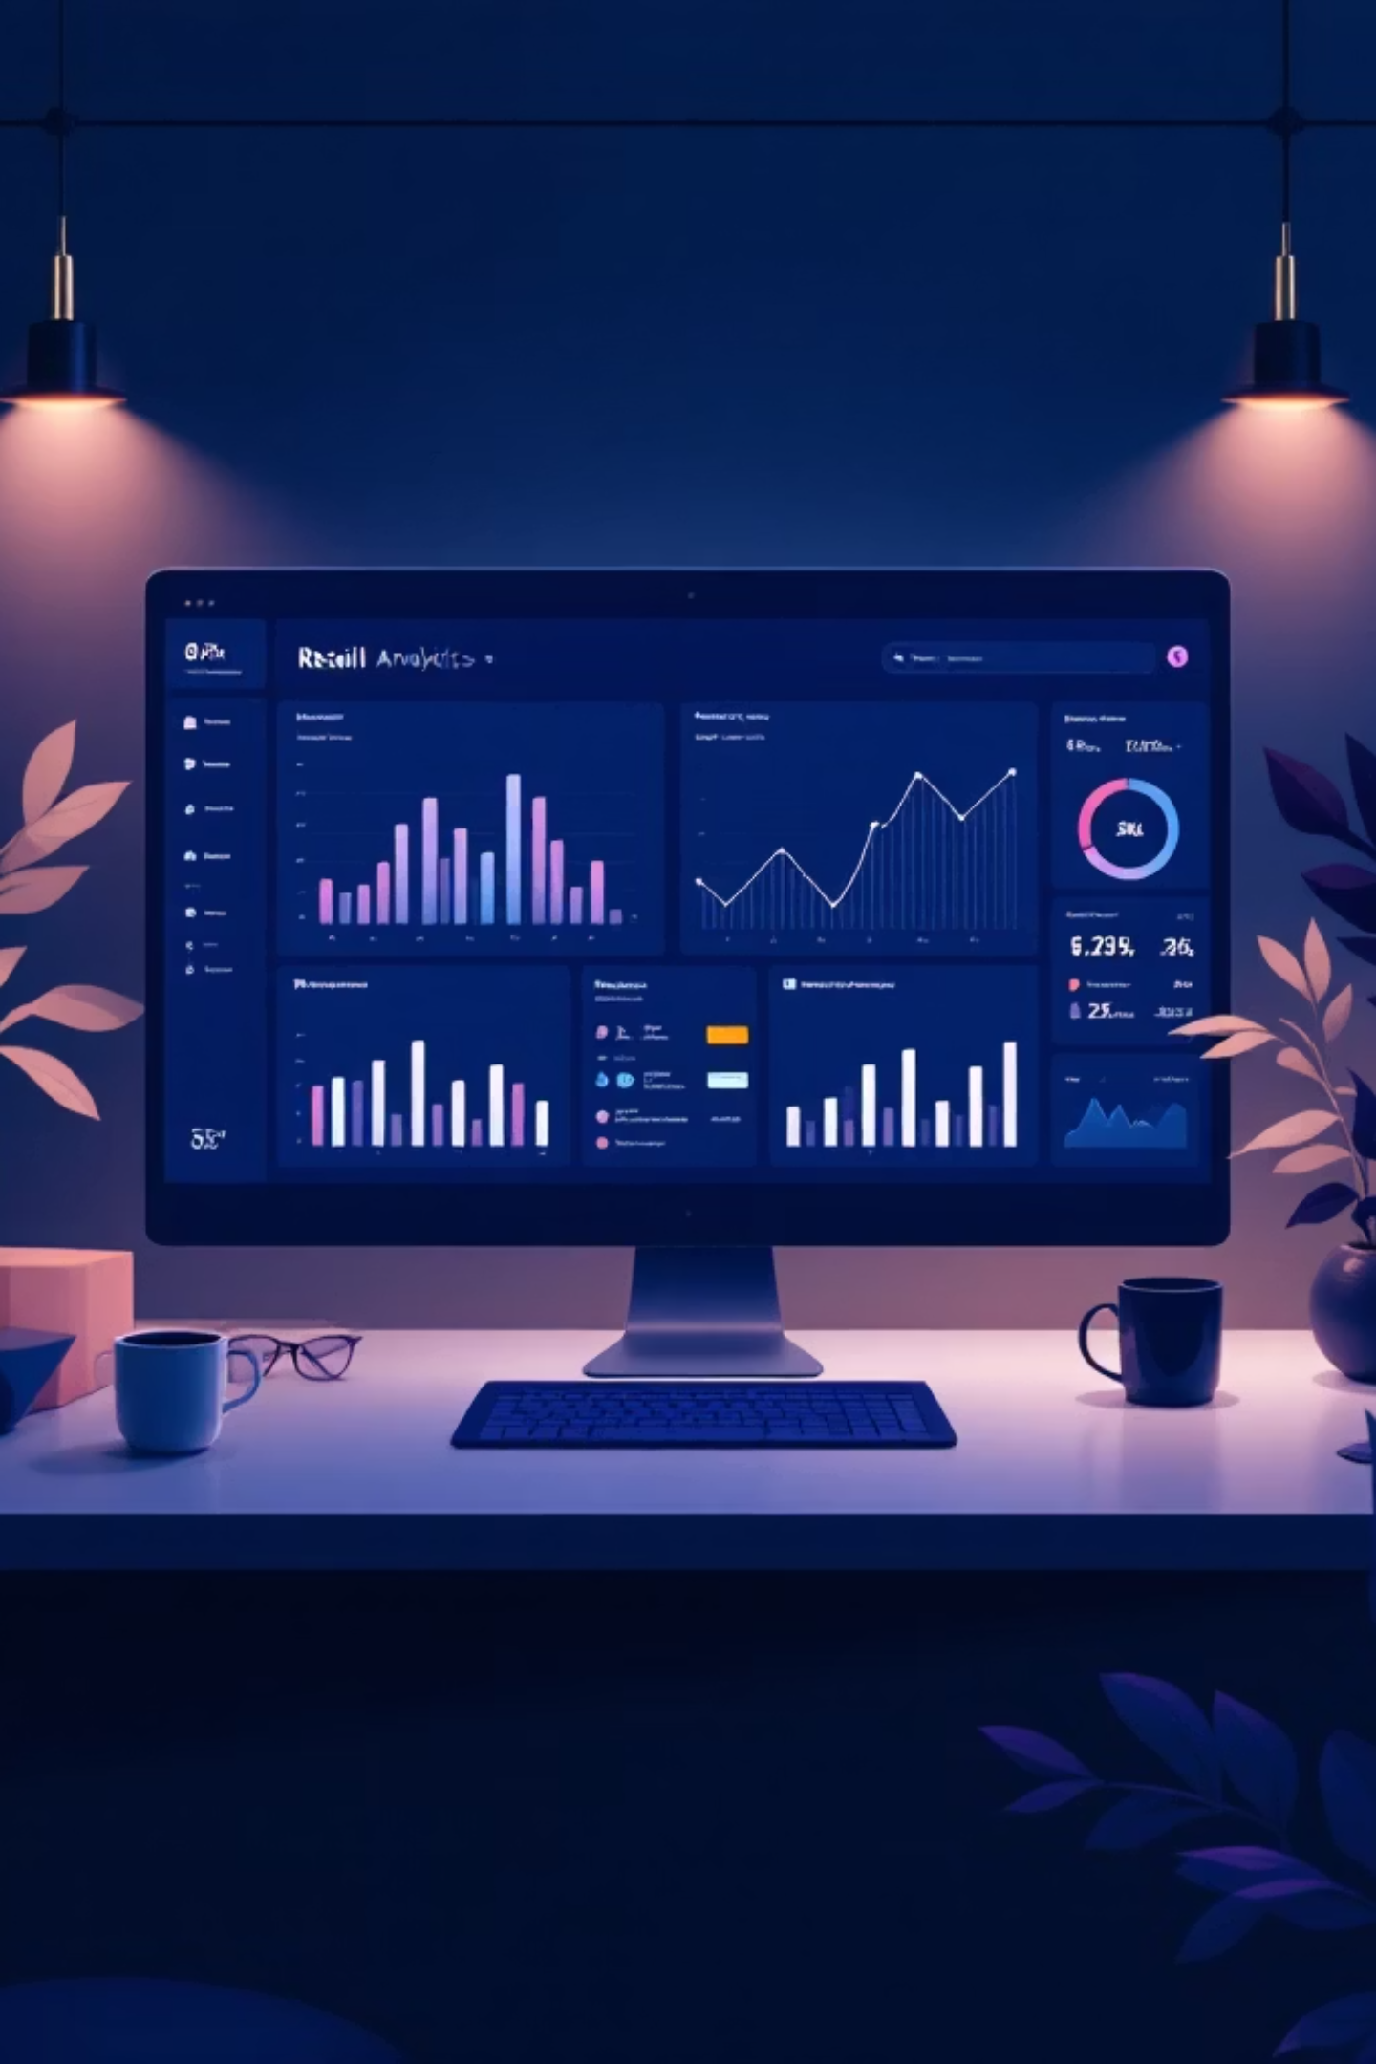
Customer Trends Data Analysis
Transforming shopping behavior into actionable business insights

Slide 2


CHALLENGE
The Business Problem
Changing Customer Behavior
Shopping patterns shifting across demographics
Online vs. offline channel dynamics
Multiple factors influencing purchases
Raw data exists but lacks insights
Core Question: How can we leverage shopping data to identify trends, improve engagement, and optimize strategies?

Slide 3

Strategic Goals
Business Goals
Increase sales and revenue
Improve customer satisfaction
Build long-term loyalty
Data-driven decision making
Analytical Goals
Analyze behavior across demographics
Identify purchase drivers
Segment customers effectively
Deliver actionable insights

Slide 4
DATASET
Data Foundation
3,900
18
37
Total Records
Attributes
Missing Values
Review ratings imputed
Key Attributes
Age, Gender, Location, Item Purchased, Category, Purchase Amount, Season, Discount Applied, Review Rating, Shipping Type, Subscription Status, Purchase Frequency
Source
Kaggle: Customer Shopping Behavior Dataset

Slide 5
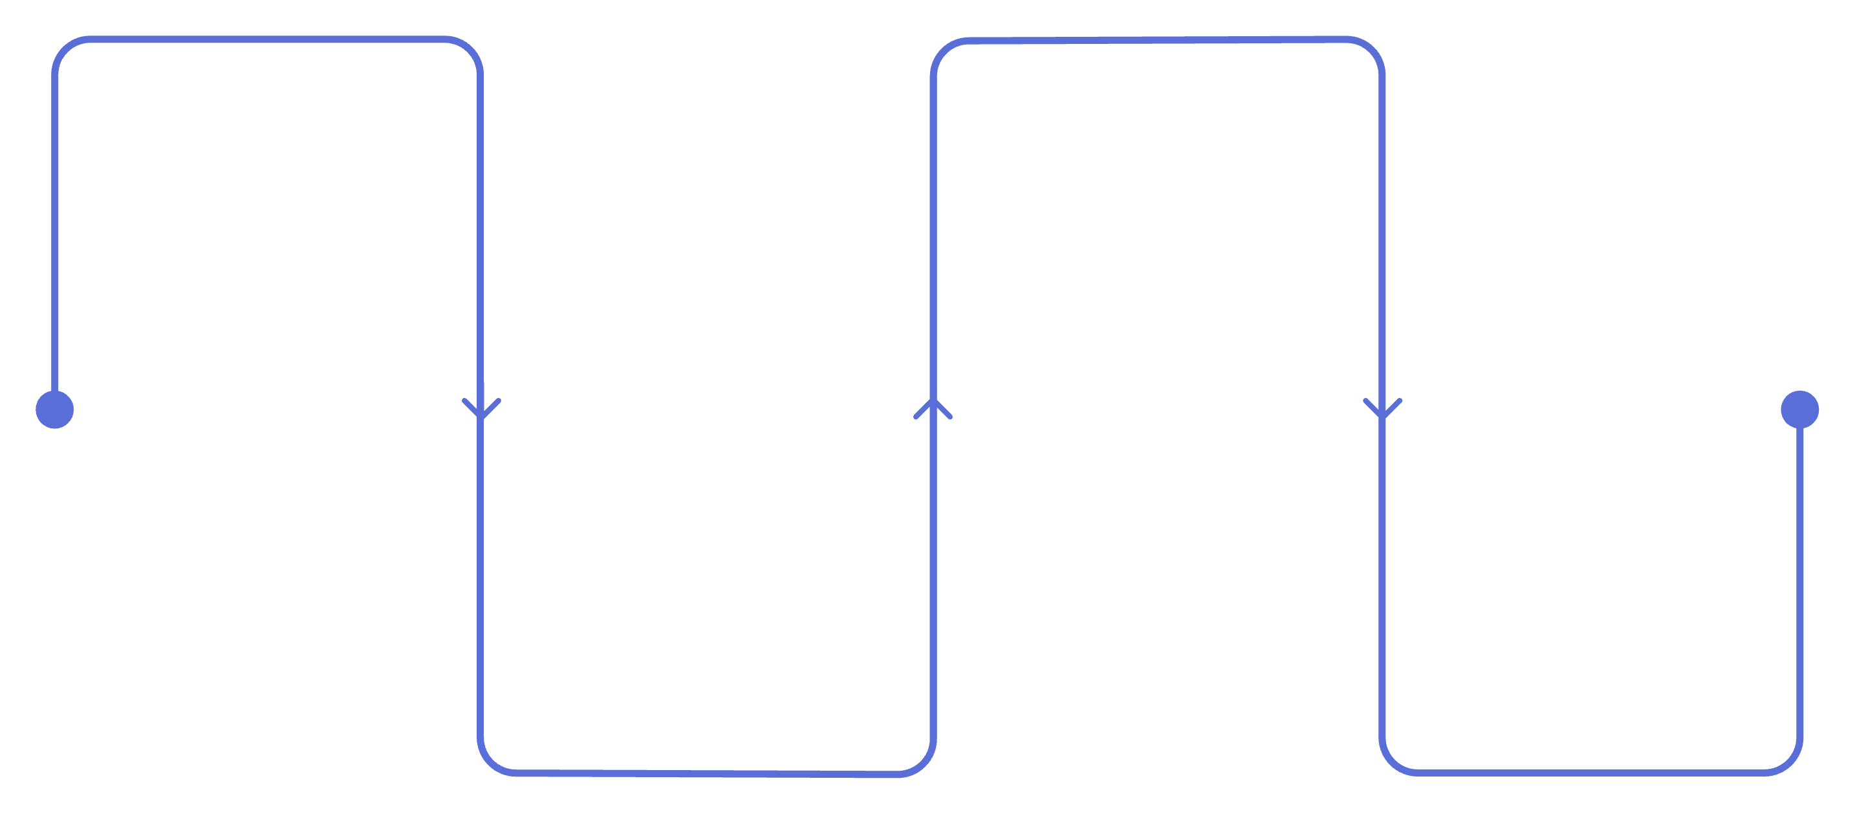
Data Preparation Process
Load & Inspect
Feature Engineering
Read datasets and preview
Create age, frequency, segment
Quality Validation
Handle Missing Data
Remove redundancies and test
Impute with category medians
Missing review ratings replaced with category-wise median. Redundant columns removed. New features created for age groups, purchase frequency, and customer segments.
Tools Used
Assumptions
Python (pandas), PostgreSQL, Power BI, Jupyter Notebook
Review behavior consistent within categories. High frequency = loyalty indicator.

Slide 6





INSIGHTS
Key Findings from EDA
Gender Revenue Gap
Shipping Insights
Loyalty Impact
Subscription Paradox
Male customers generated higher total revenue than females
Express shipping users spent significantly more per transaction
Small group of loyal customers drove majority of purchases
Similar average spend, but non-subscribers contributed more total revenue

Slide 7
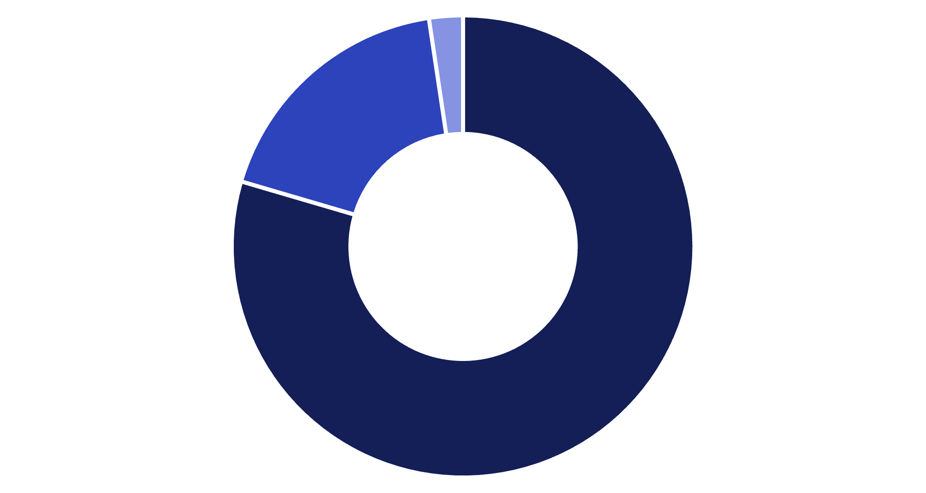
Customer Segmentation Results
Segment Breakdown
Loyal customers dominate the dataset and represent the primary revenue engine.
Loyal: 3,116
10+ previous purchases
Returning: 701
2-10 previous purchases
New: 83
Loyal
Returning
New
1 previous purchase

Slide 8





Strategic Recommendations
Reward Loyalty
Exclusive offers for loyal and repeat buyers
Monitor Discounts
Control margins on discount-heavy products
Promote Subscriptions
Aggressive marketing of subscription benefits
Target Express Users
Focus on high-spending shipping segment

Slide 9
NEXT STEPS
Limitations & Future Work
Current Limitations
Future Enhancements
No real-time data integration
Limited behavioral attributes
Payment method data missing
Static analysis snapshot
Churn prediction modeling
RFM-based segmentation
Campaign performance tracking
Real-time dashboard updates
Personalization algorithms

Slide 10

Conclusion
Raw customer data successfully transformed into actionable business insights
What We Achieved
Business Impact
Clear customer segmentation, behavior patterns identified, revenue drivers uncovered
Smarter marketing decisions, improved retention strategies, data-driven optimization
Path Forward
Enhanced predictive capabilities, stronger personalization, continuous improvement

